Slide 1

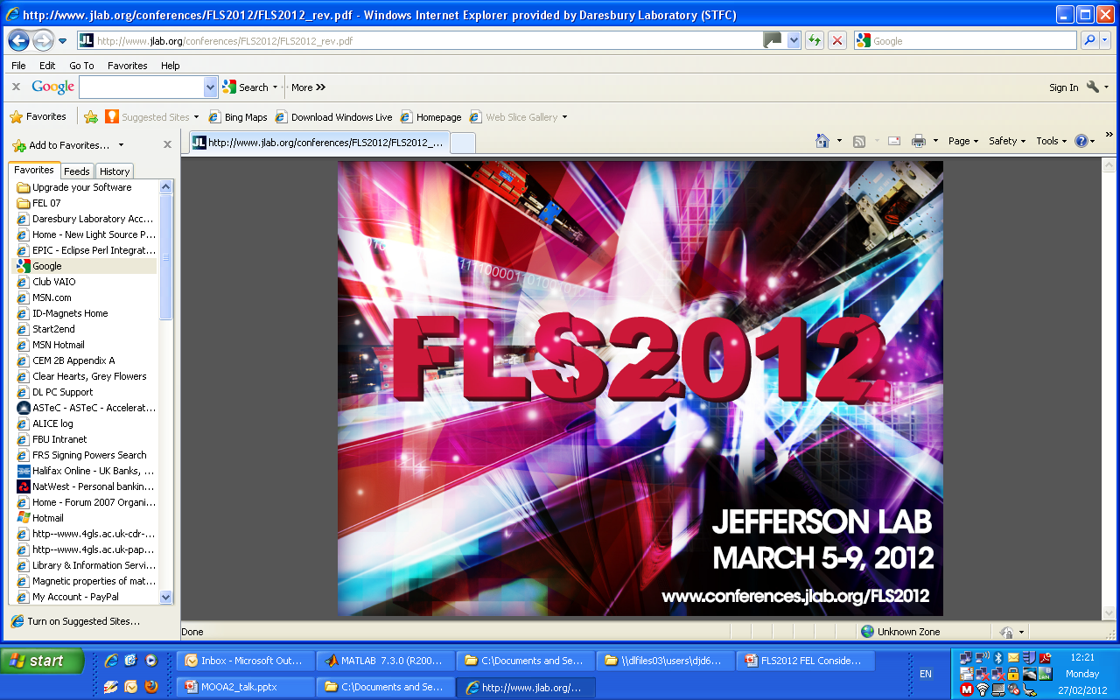


FEL Considerations for CLARA: a UK Test Facility for Future Light Sources
David Dunning
On behalf of the CLARA team
8th March 2012

Slide 2

Introduction
Proposal for a new FEL test facility in the UK:
CLARA – Compact Linear Advanced Research Accelerator.
Early stages – focus on general aspects rather than specifics where possible.
Contents:
  Motivating factors for a new FEL test facility
  International Context (facilities/concepts)
  Objectives
  Machine Requirements
  Machine design (Including first stage already funded)
  FEL concepts

Slide 3
Motivating Factors for a New FEL Test Facility
“Local”
“International”
Ultimately aiming for a state-of-the-art FEL user facility in the UK.
We have a team with the skills to design (e.g. 4GLS & NLS) and commission (e.g. ALICE facility, including demonstration of IR-FEL) a major facility – want to maintain and develop this team.
We have recurrent funding for accelerator R&D on ALICE which we want to re-direct, plus opportunities for capital investment (recently received £2.5M for EBTF – will be first stage of CLARA).
A building is available with space and the required infrastructure from the recently de-commissioned SRS at Daresbury Laboratory.
There are many ways in which FELs could be further improved: temporal coherence, synchronisation and stability, short pulses, shorter wavelength, higher power, serving more users, tailored pulse structures, reducing machine size and cost… more details on later slide.
We have some of our own novel ideas to address these frontiers. The FEL community has many more…
There are only a few dedicated FEL test facilities, and lots of areas to investigate.
Potential for a new test facility to look at frontiers beyond the current priorities.
i.e. there is an opportunity to develop a new FEL test facility which makes best use of our existing resources… while preparing for a future user facility… and contributing to international FEL R&D

Slide 4
Contents
  Motivating factors for a new FEL test facility
  International Context (facilities/concepts)
  Objectives
  Machine Requirements
  Machine design (Including first stage already funded)
  FEL concepts

Slide 5
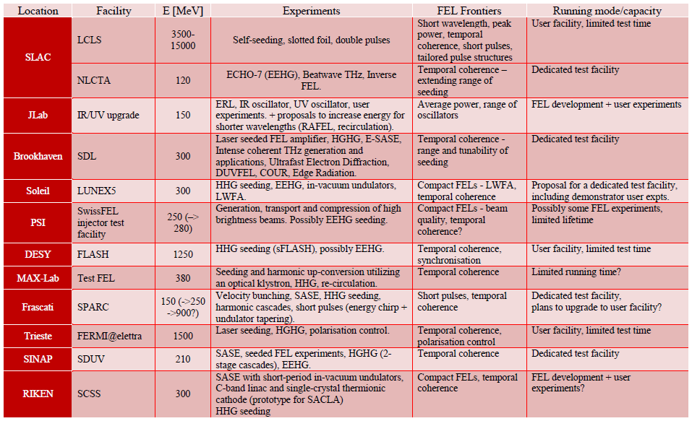
Reviewing the field – Facilities
Many facilities involved in FEL test experiments but perhaps only 5-6 might be considered dedicated FEL test facilities.
Highest current priority for FELs is improving temporal coherence.
Reducing size and cost is another common theme.
Potential opportunity for a FEL test facility looking at next frontiers.
There is demand for a higher energy (~1GeV) test facility – but CLARA will be smaller scale than this.
Some relevant facilities for FEL test experiments:

Slide 6
Reviewing the field – Concepts
There are areas in which a new FEL test facility could contribute to international R&D (e.g. many short pulse schemes proposed but not tested). There are other methods which are already being studied extensively (e.g. seeding) which we still want to study both to develop local expertise and because they are fundamental to other novel concepts. (Plus new concepts will emerge over the course of the project)
SASE
COMPACT FELS
HARMONICS
Phase shifting
SHORT PULSES
Slicing
    current enhancement
    chirp+taper
Mode-locking
Energy modulation + short undulator
Single spike SASE
Superradiance
TEMPORAL COHERENCE
Direct seeding: 800nm, IR, VUV HHG
Self seeding: crystal, grating, monochromatic wake
Electron delays (distributed self seeding / filtering)
Echo Enabled Harmonic Generation (EEHG)
High Gain Harmonic Generation (HGHG)
STABILITY and SYNCHRONISATION
NOVEL UNDULATORS
Short period
Superconducting
Variable period
Variable polarisation
TAILORED PULSE STRUCTURES
SERVING MULTIPLE USERS
FEL EFFICIENCY
CSE
DIAGNOSTICS
Single shot pulse profiles
Single shot spectra
Undulator SE
Coherent emission from bunched beam: mapping out higher order bunching
LASER INTERACTIONS
Energy modulation without undulator
Synchronisation
Compression
Acceleration
PLASMA ACCELERATED
-LIKE BEAMS
Radiation extraction
FEL with large energy spread?

Slide 7
Contents
  Motivating factors for a new FEL test facility
  International Context (facilities/concepts)
  Objectives
  Machine Requirements
  Machine design (Including first stage already funded)
  FEL concepts

Slide 8
Ultimate aims of CLARA
A number of objectives for CLARA have been formulated based on reviewing the field, the ultimate aims are:
Stable in terms of transverse position, angle, and intensity from shot to shot.
A target synchronisation level for the photon pulse ‘arrival time’ of better than 10 fs rms is proposed.
In this context “ultra short” means less than the FEL cooperation length, which is typically ~100 wavelengths long (i.e. this equates to a pulse length of 400 as at 1keV, or 40 as at 10 keV). A SASE FEL normally generates pulses that are dictated by the electron bunch length, which can be orders of magnitude larger than the cooperation length.
To develop a normal conducting test accelerator able to generate longitudinally and transversely bright electron bunches and to use these bunches in the experimental production of stable, synchronised, ultra short photon pulses of coherent light from a single pass FEL with techniques directly applicable to the future generation of light source facilities.
Slide courtesy of Jim Clarke

Slide 9
Other Aims and Prerequisites
To deliver the ultimate objectives of CLARA will encompass development across many areas:
Generation and control of bright electron bunches
  manipulation by externally injected radiation fields
  mitigation against unwanted short electron bunch effects (e.g. microbunching and CSR)
Low charge single bunch diagnostics
NC RF photoinjectors and
seed laser systems
High temporal coherence and wavelength FEL stability through seeding or other methods
Synchronisation systems
Generation of coherent higher harmonics of a seed source
Advanced low level RF systems
Photon pulse diagnostics for single shot characterisation and arrival time monitoring
Novel short period undulators

Slide 10
Contents
  Motivating factors for a new FEL test facility
  International Context (facilities/concepts)
  Objectives
  Machine Requirements
  Machine design (Including first stage already funded)
  FEL concepts

Slide 11
Electron Beam Energy and Undulator Period Requirements
Many of the FEL concepts we could study involve interactions between laser sources and the electron beam. Neil Thompson has carried out a study to assess the requirements for the machine parameters:
If we assume minimum undulator gap of 6mm and a_{w} > 0.7, we can generate contour plots for the required electron beam energy and undulator period to give a required tuning range.
For the radiator to be tuneable between 2nd Harmonic of Ti:Sa at 400nm, to HHG at 100nm, a working point of ~250MeV electron beam energy, and 29mm undulator period is required. (50nm could be reached at 250MeV but with little tunability – low a_{w})
X
X
X
X
X
Gap tuning between 2nd Harmonic of Ti:Sa at 400nm, to HHG at 100nm: 237MeV / 29mm
Plots courtesy of Neil Thompson
X
Range could be extended to include fundamental of Ti:Sa at 800nm through energy tuning

Slide 12
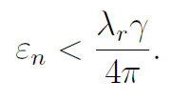
Emittance Requirement
For a given radiation wavelength and electron beam energy, we can estimate the required maximum emittance. Lower emittance will help improve FEL performance, and there will be a separate programme to develop low emittance beams.
For FEL at 100nm with 250MeV beam, need normalised emittance
< 4mm-mrad
4
Plot courtesy of Neil Thompson

Slide 13
Provisional Parameters
The provisional parameters are given below. We want CLARA to be as flexible and configurable as possible so the parameters are evolving depending on results of modelling different FEL configurations.
Parameter | Value
Beam Energy | 250 MeV
Minimum Gap | 6 mm (provisional)
Radiator Period | 29 mm (provisional)
Radiator Tuning | 100-400 nm (2nd to 8th harmonic of Ti:Sa + HHG)
Bunch Charge | 20-250 pC
Emittance | 0.2 – 2.0 mm-mrad (from injector simulations)
Seed Sources | 800nm Ti:Sa + 100 nm HHG
Afterburners | To reach 50 nm, novel undulator technology
Modulators | Strong R₅₆ to enable EEHG

Slide 14
Contents
  Motivating factors for a new FEL test facility
  International Context (facilities/concepts)
  Objectives
  Machine Requirements
  Machine design (Including first stage already funded)
  FEL concepts

Slide 15
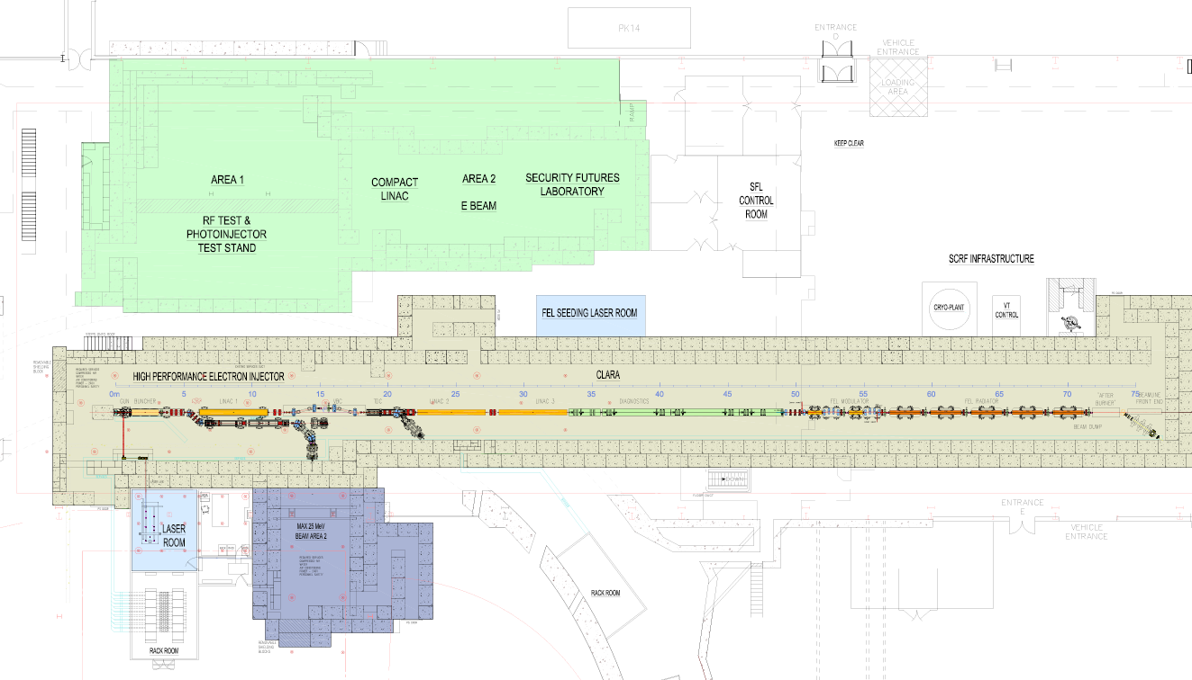
Preliminary Layout
A preliminary layout for CLARA has been established. CLARA will utilise the (Electron Beam Test Facility) as a first stage - funded and under construction. This consists of a 2.5-cell S-band RF gun, diagnostics and transport to two experimental areas for industrial applications.
~80m
EBTF
(Under Construction Now)
Work In Progress

Slide 16
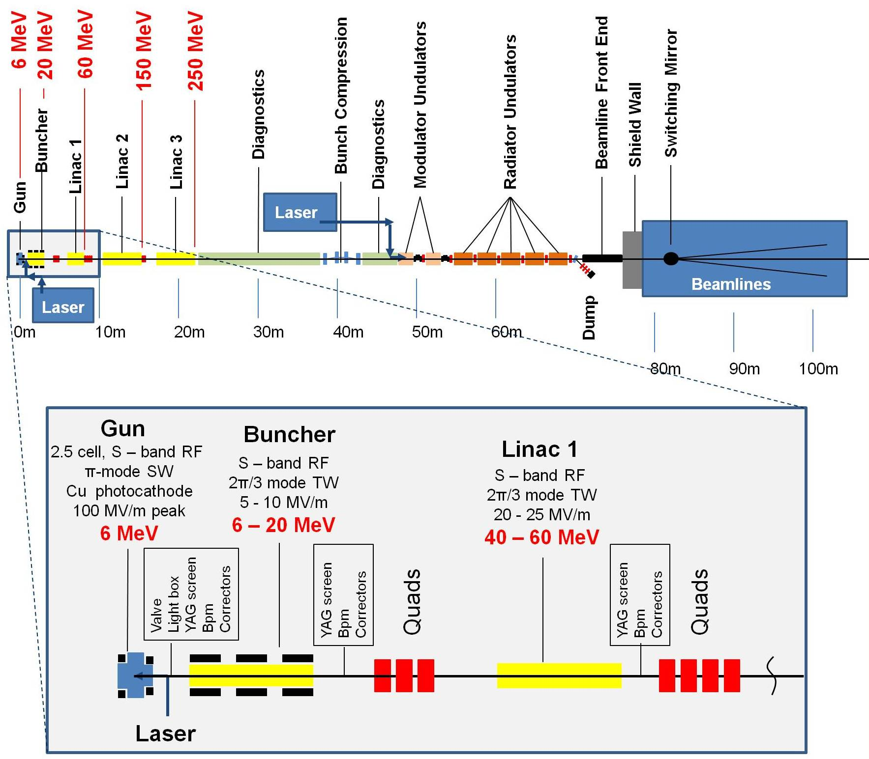
Schematic Layout
Work In Progress

Slide 17
Flexible FEL Layout
0m
3m
6m
9m
12m
15m
18m
21m
e-beam
Laser seed
reconfigurable
We want the FEL layout to be as flexible as possible particularly in terms of the modulator, to allow us to test a number of different concepts.
We’re starting to compare the various schemes and their detailed requirements.
We aim to design in this flexibility from the start.
Chicane (1m long)
Diagnostic/Matching Section
Modulator Undulator (1.5m long)
Radiator Undulator (2.5m long)
Work In Progress

Slide 18
Contents
  Motivating factors for a new FEL test facility
  International Context (facilities/concepts)
  Objectives
  Machine Requirements
  Machine design (Including first stage already funded)
  FEL concepts

Slide 19
FEL Schemes and Seed Sources
There are lots of concepts that we might want to consider. Studies are being carried out to assess the viability of some of these schemes on CLARA. The results are being used to feed back on the machine requirements.
Seeding + Harmonic Generation (e.g. EEHG)
SEED: THz?
Short Pulse Schemes:
Synchronisation and Stability
  Single Spike SASE
  Laser Slicing (many variations)
    SEED: MID-IR source for energy modulation - OUTPUT: VUV
  Mode-Locking
    SEED: MID-IR source for energy modulation - OUTPUT: VUV
  Energy-Modulation + short radiator
    SEED: MID-IR source for energy modulation - OUTPUT: VUV
  EEHG or HGHG
    SEED : 800nm Ti:Sa - OUTPUT: UV / VUV to 100nm (high power) or 50nm (low power)
  Direct Seeding
    SEED: 800nm Ti:Sa / HHG @ 100nm - OUTPUT: 800-100nm

Slide 20
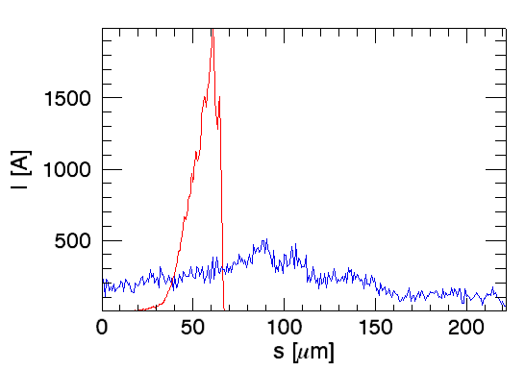
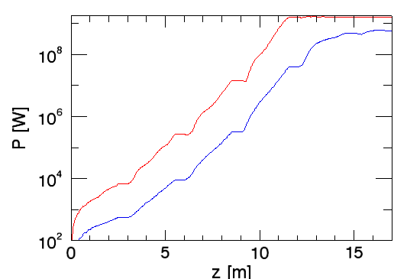
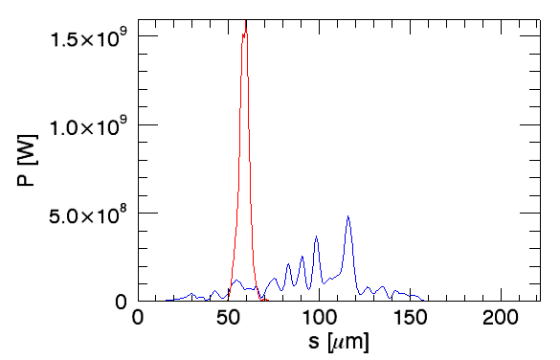
SASE and Single-Spike SASE
Initial start-to-end simulations have been carried out for SASE and single-spike SASE operating modes – as a starting point for further work.
The FEL output is shown for both the SASE case where magnetic compression is used and a single-spike SASE cases where velocity bunching is used.
~20fs
FWHM
(~60 optical cycles)

Slide 21
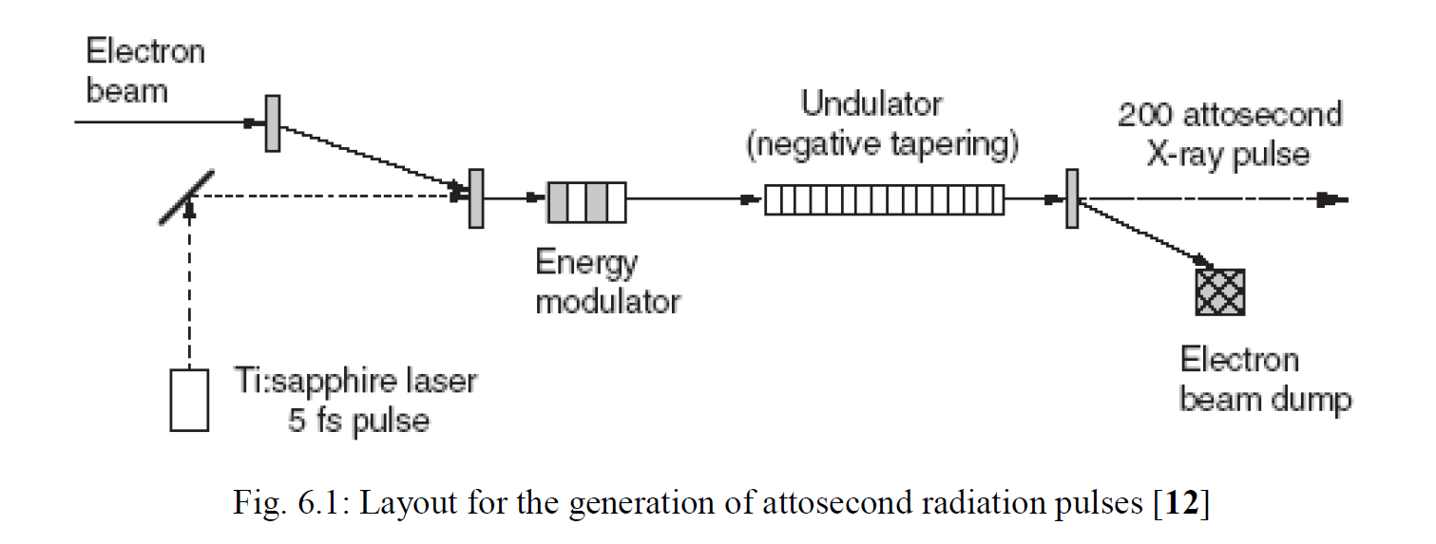
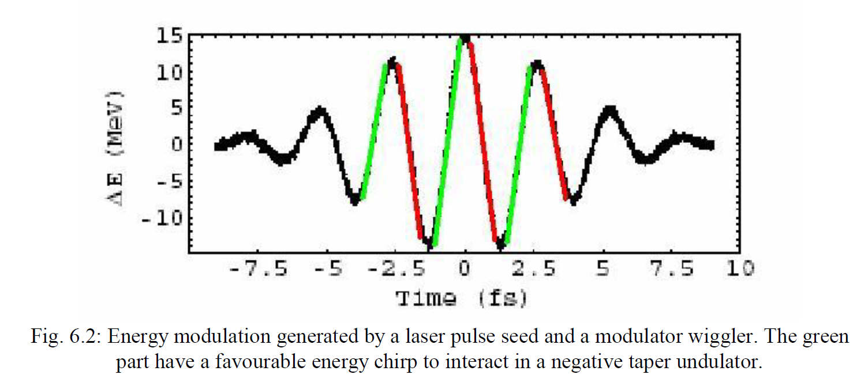
Laser Slicing (1)
Ian Martin (Diamond Light Source) has started modelling one of the laser slicing schemes:
E.L. Saldin et al.,
Phys. Rev. STAB, 9, 050702, (2006).
e-beam
CLARA CONFIG.
Laser seed

Slide 22
Laser Slicing (2)
Results show the implementation of this scheme on CLARA for several different combinations of laser parameters (wavelength/pulse energy/duration). Output is shown at 14.8m into radiator. The number of spikes is increased due to >1 periods in modulator.
10μm/10 μJ/100fs
20μm/20 μJ/167fs
20μm/1 μJ/167fs
~13fs
FWHM
(~39 optical cycles)
Plots courtesy of Ian Martin, DLS

Slide 23
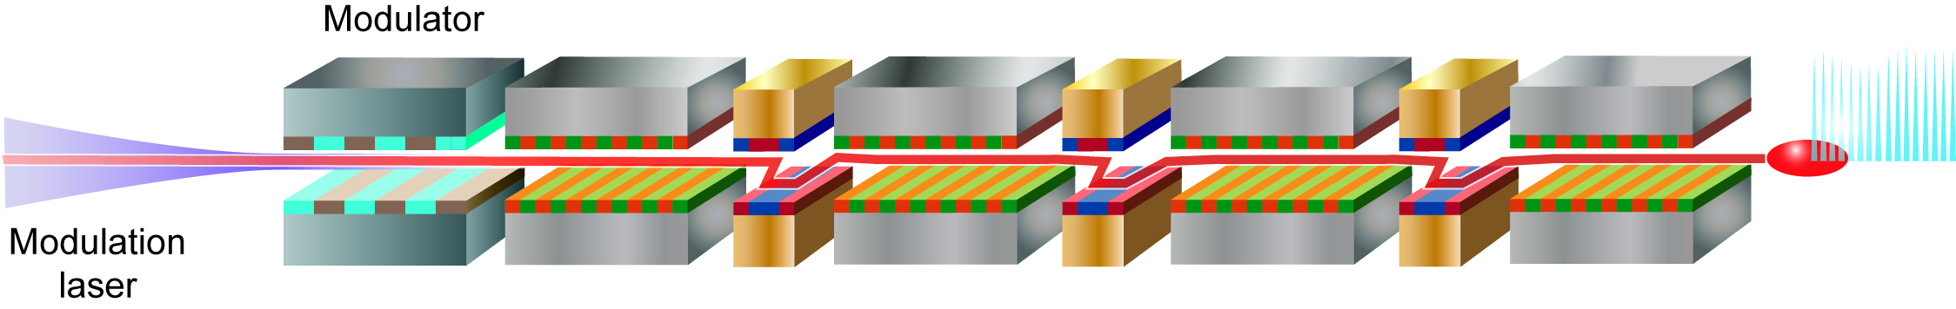
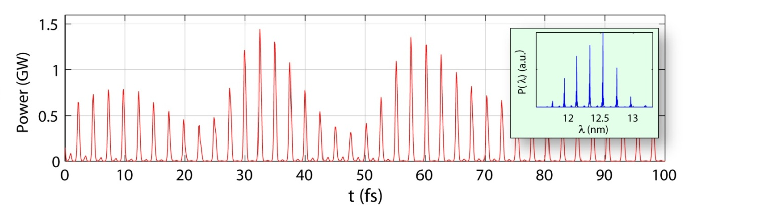
Mode-locked FEL amplifier (1)
Another scheme under consideration is the mode-locked FEL amplifier, predicted to generate pulse trains with individual pulses shorter than the FEL cooperation length (number of optical cycles ≈ number of periods per undulator module).
We’re considering whether the CLARA radiator could have insertable chicanes in the undulator modules to effectively reduce the undulator module length, and so access shorter pulses from the mode-locked technique.
N. Thompson and B. McNeil,
Mode-Locking in a Free Electron Laser Amplifier,
Phys. Rev. Lett., 100, 203901, (2008).
e-beam
CLARA CONFIG.
Laser seed

Slide 24
Mode-locked FEL amplifier (2)
Neil Thompson has carried out some preliminary modelling of the mode-locked FEL on CLARA operating with standard undulator modules.
The characteristic pulse train behaviour is predicted (left plot). Using shorter undulator modules would allow shorter pulses to be accessed. When the electron beam delays are matched to the electron bunch length (right plot), the output is approximately single-spike.
Pulse Train output
(delays ~24fs)
Single Spike output
(delays matched to rms electron bunch length ~60fs)
E ~ 8 µJ
E ~ 0.1 µJ
P (MW)
16fs FWHM
(~48 optical cycles)
P (MW)
12fs FWHM
(~36 optical cycles)
t (fs)
t (fs)
Plots courtesy of Neil Thompson

Slide 25
Next Steps.....
Finalise the basic parameters (2011)
Firm up the conceptual layout (2011)
Carry out detailed design (2012-3)
Secure the funds ... (2012-3?)
Build up CLARA ... (2012 – 2014?)
Run CLARA ... (2015 – ???)

Slide 26
Summary and Outlook
Potential for a new FEL test facility to look at frontiers beyond the current priorities.
We want CLARA to be as flexible as possible to test a number of concepts – need to factor this into our designs.
Although our stated emphasis is short pulse generation we also anticipate much work on other topics including seeding, harmonic generation + emerging concepts.
Have to consider the scalability of concepts tested at 250MeV to shorter wavelengths.
Should we plan experiments at longer wavelengths to make diagnostics simpler?
Want CLARA programme to be compatible with international R&D programmes – we welcome international partners, contributions and collaborations.
Thank you for your attention

